Slide 1
Bias, Blindness and Bursted Bubble: Examination of Public Sentiment on Social Media Platforms*
Daniel Kim (George Washington University)
POMS Annual Meeting 2019, May 3-6
* Joint work with Yixin Lu (George Washington University)

Slide 2
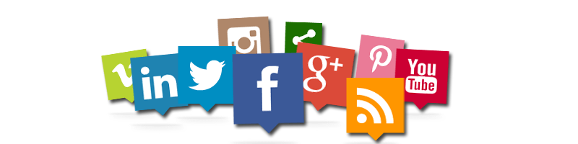
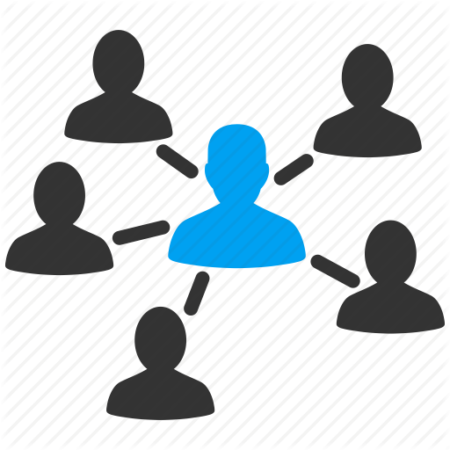

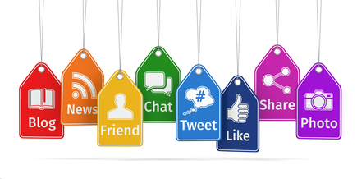
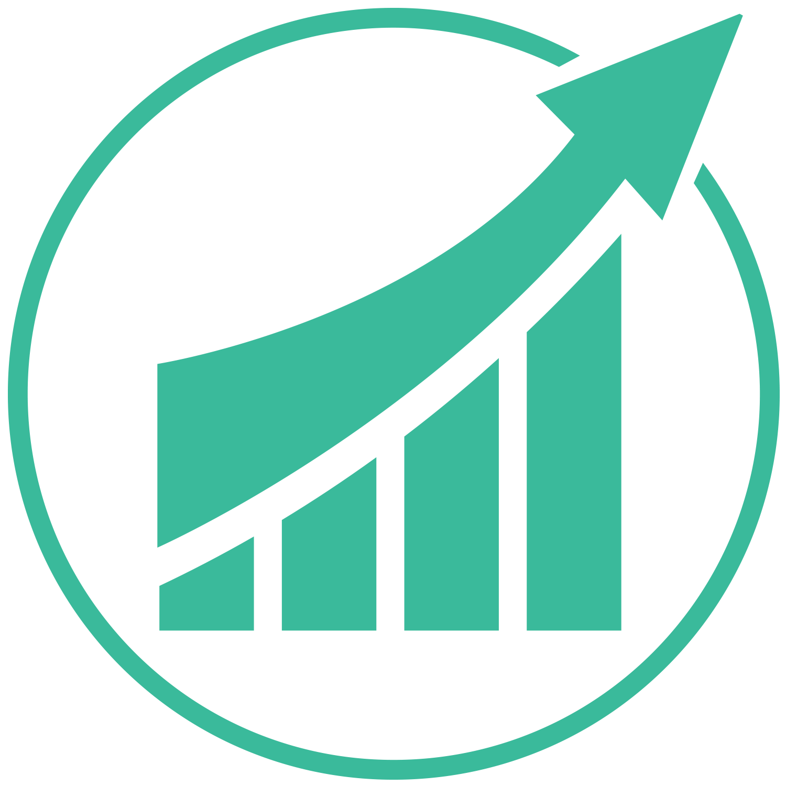
Social Media Platforms
Connect people from all over the world and improve understanding
Facilitate information discovery
Offer businesses effective channels to understand customers’ needs

Slide 3
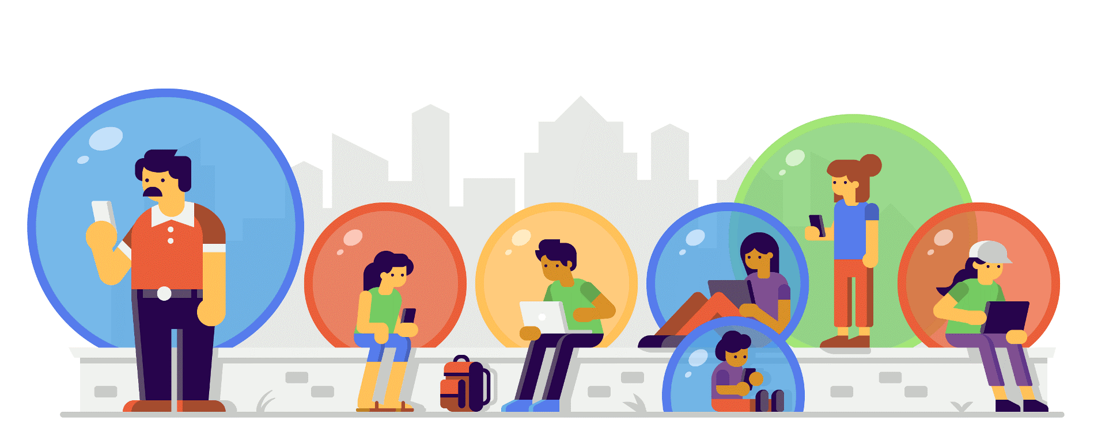
Filter Bubble
A state of intellectual isolation resulting from personalized algorithms that selectively present users what they would like to see based on their past behaviors (e.g., location, search, browsing content).
Source: https://spreadprivacy.com/google-filter-bubble-study/
Notes:
As a result, users become separated from information that disagrees with their viewpoints, effectively isolating them in their own cultural or ideological bubbles.

Slide 4
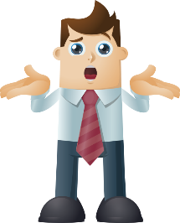
The Problem
(Technology such as social media) “let you go off with like-minded people, so you're not mixing and sharing and understanding other points of view ... It's super important. It's turned out to be more of a problem than I, or many others, would have expected.”
— Bill Gates 2017 in Quartz
How information policies adopted by different social media platforms impact users’ content generation and sharing?
Would transparent policies perform better in mitigating bias and facilitating inter-group communication?
Notes:
Understanding how users interact and produce content at social networking sites becomes increasingly important. Insight into community dynamics are valuable for measuring content quality, evaluating group stability and growth, and guide policy interventions (preventing cyber bullying and online harassment)
we want to understand differences in social media platforms how do their design and structure affect users’ content and generation
we look at reddit and twitter to understand differnces. Understanding designs that improve and burst the bubble can help create new designs and apps

Slide 5
Literature Review
Social Presence
Blau (1964): individuals engage in social interactions based on expectations of social rewards (e.g., reputation, status); social exchange theory.
Sia et al. (2002): increased social presence makes individuals less divergent or disagreeable in their thinking
Ariely et al. (2009): image motivation (the desire to be liked and well regarded by others) contributes to prosocial behavior
Huang et al. (2017): integration of Facebook on Yelp and TripAdvisor increased the production of reviews but decreased cognitive language.
Connectivity
Butler (2001): online communities are sustainable only if they have access to resources that benefit their members; curvilinear effect of community size
Twitter - higher image motivation and social presence
Reddit - less image motivation and social presence
Notes:
larger community size brings in more resources but reduces the peer interaction; it also negatively affect individuals’ perception and attitudes as large community is more susceptible to free-riding
some ideas we draw upon - image motivation SOCIAL PRESENCE - how close to other people?
Reddit: two-way communication, voting mechanism; Twitter: broadcasting, trendiness of the topic matters most

Slide 6


Data Collection
330 mln active users, 06:23 mins per day (by April 2018*)
Non-anonymous, user-centric
Parsehub webscraper (Tweepy API can’t search by date)
Twitter advanced search to collect tweets -random sample
330 mln active users, 15.47 mins per day (by April 2018*)
Anonymous, content-centric (with User profiles)
Reddit pushift API
Collect comments from threads that contain the keywords
also random sample
*Source: https://thenextweb.com/contributors/2018/04/19/reddit-now-active-users-twitter-engaging-porn/
Notes:
Facebook: 2 billion active users, average time: 11 min
Youtube: 1.5 billion active users, average time: 08.15 min
On twitter, we follow people, whereas on Reddit, people are following subjects of interest. In addition, items of information are voted by the reddit community by importance, so unlike Twitter’s stream which can have trends, reddit items are actually voted down or up by its users so technically, you get items that may be arguably the most relevant/of interest within each subreddit.

Slide 7
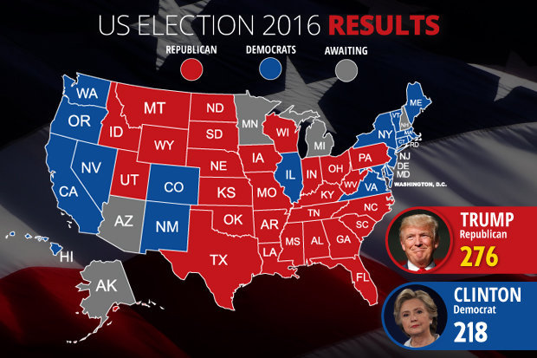
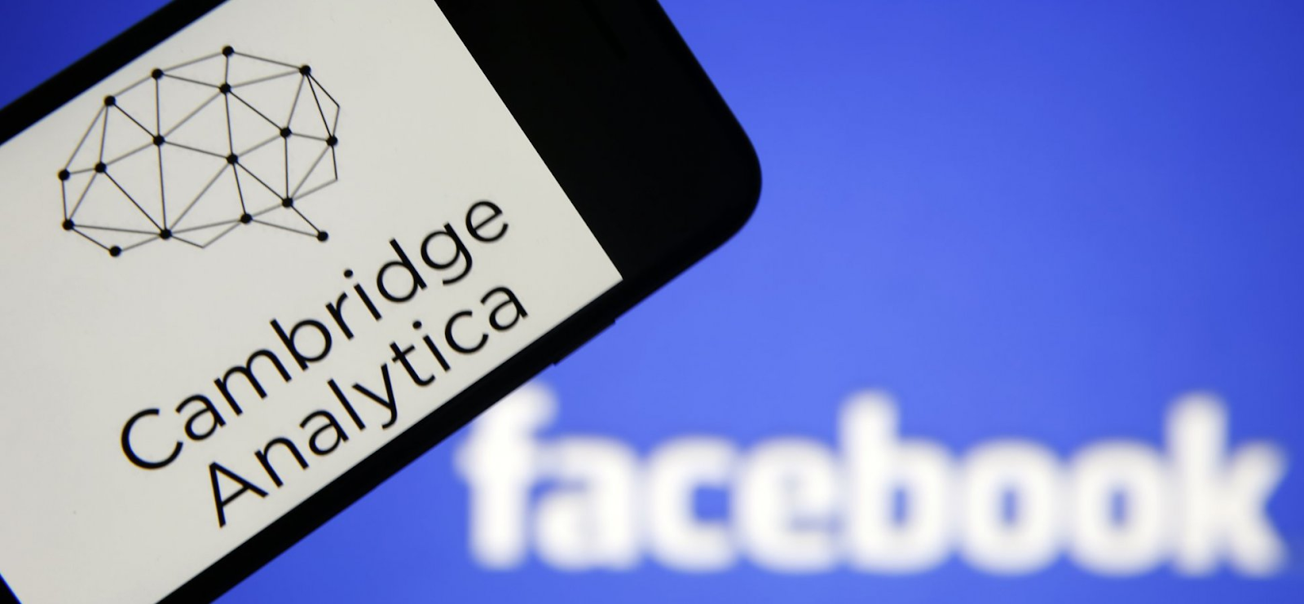
Focal Events
US 2016 Election
(Nov. 1- Nov.15, 2016)
Facebook Cambridge Analytica Scandal
(Apr 3 – Apr. 17, 2018)
Notes:
For election: we would expect users’ tweets or comments be more polarized, given their political views or ideologies; For Facebook Cambridge, we would expect more consensus: e.g., people are concerned about online privacy. fb ca focus specifcally on April 10 Mark Zuckerberg’s hearing in Congress

Slide 8
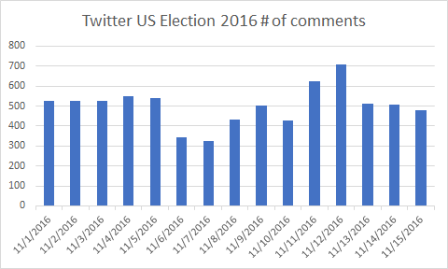
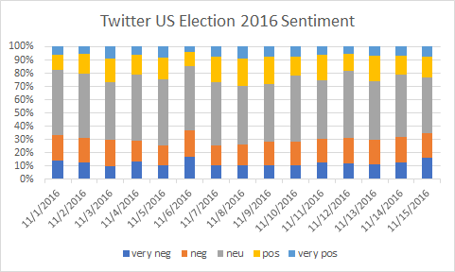
Twitter: US 2016 Election
Approximately 50% of the comments were neutral during the focal timeframe.
Distribution of #Tweets over Time
User Sentiment Variation
No Major Spikes.
Notes:
us 2016 election, stable first 5 days then drops nov 6 and then increases after 8th and then goes back to level 13th –present
sentiment: here we see that tweets for the us 2016 election had a greater amount of neutral sentiment (grey) and negativity steadily rose after november 8. Neg below 40%. Positivity increases up to election day and then falls

Slide 9
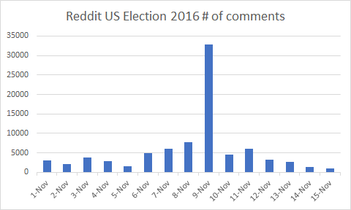
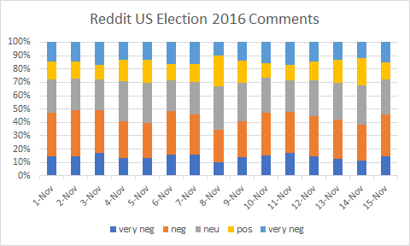
Reddit: US 2016 Election
Distribution of #Comments over Time
Approximately 30% of the comments were neutral during the focal timeframe.
User Sentiment Variation
1st Day after Election
Notes:
us election 2016 increase from Nov6 and then skyrockets nov 9. Thn plummets
sentiment: here one sees that negativity is lowest on Nov 8 election day and positive sentiment is highest. Negative above 40% and positive around 30%

Slide 10
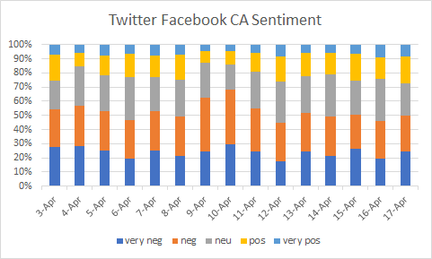
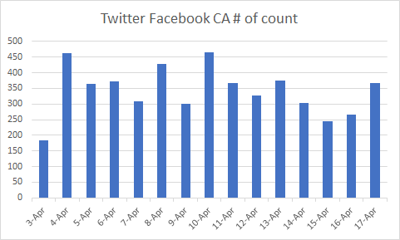
Twitter: FB Cambridge Analytica
User Sentiment Variation
April 10: Zuckerberg Public hearing
Distribution of #Tweets over Time
Approximately 50% of the comments were negative during the focal timeframe except for April 9 & 10.

Slide 11
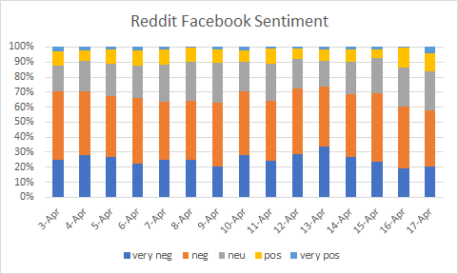
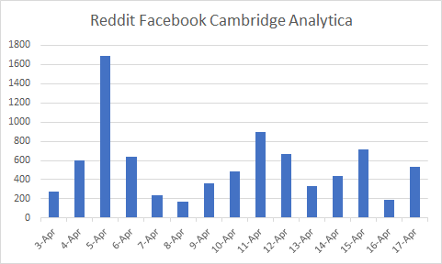
Reddit: FB Cambridge Analytica
User Sentiment Variation
March 17: Expose
March 20: FTC inquiry
March 21: Zuckerberg first responded
April 10: Public hearing
Distribution of #Comments over Time
Approximately 70% of the comments were negative during the focal timeframe.
Notes:
Do we have similar thing from Twitter?

Slide 12
Summary of Findings
Sensitive/reactive towards major public events
Interpretation: more intensive communication
Very expressive (more negative/positive words rather than neutral ones)
Interpretation: low peer pressure (image concern)
Less sensitive towards major public events
Interpretation: anchored by current trends and more likely to be blinded
Less expressive (more neutral words)
Interpretation: more likely to conform to self-selected group, more likely to be biased
Notes:
big spikes indicate greater sensitivity towards two public events. Reddit users anonymous and this can lead to lower peer pressure and more expression
twitter was more consistent and less sensitive. Image motivation is a great factor so more neutrality.

Slide 13
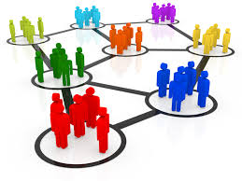
THANK YOU!

Slide 14
Twitter Advanced Search
Facebook Cambridge Analytica Event.
Data Breach, data breach, breach
Cambridge Analytica, Cambridge, Analytica, CambridgeAnalytica
Privacy
Facebook, Mark Zuckerberg, zuckerberg
deletefacebook, delete facebook
2016 US Election
@HillaryClinton, ImWithHer, Hillary, Clinton, Hillary Clinton
@realdonaldtrump, Trump, Donald Trump, MakeAmericaGreatAgain, Trump2016
2016election, uselection2016, PresidentialElection, Donald Hillary, Trump Clinton
By using variations of the same search terms we can get different tweets around the same topic

Slide 15
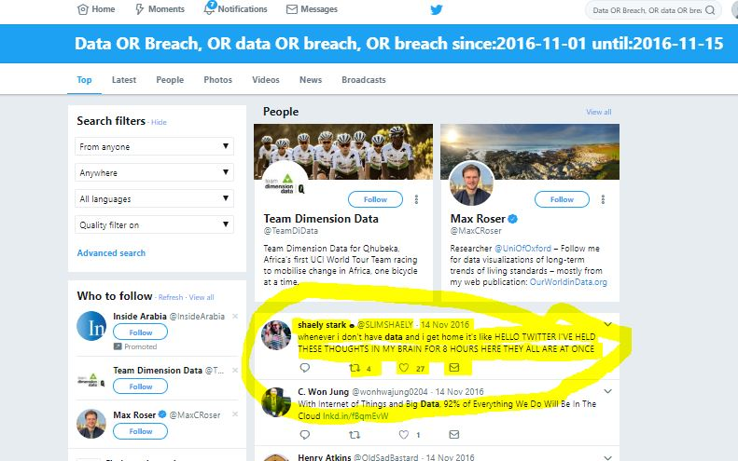
Collecting Tweets and Other Information
-from here scrolled down as far as possible
- collected @name, name, comment, date, # of msg, replies, retweets

Slide 16
Overview of the Dataset
 | Twitter | Reddit
US 2016 Election (Nov. 1- Nov.15, 2016) | 7,527 Tweets (Random Sample of All Tweets on the Topic) | 91,451 Comments
Facebook Cambridge Analytica Scandal (April 3-Apr. 17, 2018) | 4,498 Tweets (Random Sample of All Tweets on the Topic) | 8,232 Comments
Notes:
For election: we would expect users’ tweets or comments be more polarized, given their political views or ideologies; For Facebook Cambridge, we would expect more consensus: e.g., people are concerned about online privacy.
Would it be possible to collect the full sample for FB CA event on Reddit?

